Slide 1


AI Tech Labs 0⇒1
Jian Tao
jtao@tamu.edu
HPRC Short Course
10/30/2020

Slide 2
AI Tech Labs
Lab I. JupyterLab
(15 mins)
We will set up a Python virtual environment and run JupyterLab on the HPRC Portal..
04
Lab IV. Deep Learning
(30 minutes)
We will learn how to use Keras to create and train a simple image classification model with deep neural network (DNN).
01
Q&A
(5 mins/lab)
03
Lab II. Data Exploration
(30 mins)
We will go through simple examples with two popular Python modules: Pandas and Matplotlib for simple data exploration.
Lab III Machine Learning
(30 minutes)
We will learn to use scikit-learn for linear regression and classification applications.
02
Notes:
Totally 2 hours with a 5-min Q&A and break after each lab.

Slide 3

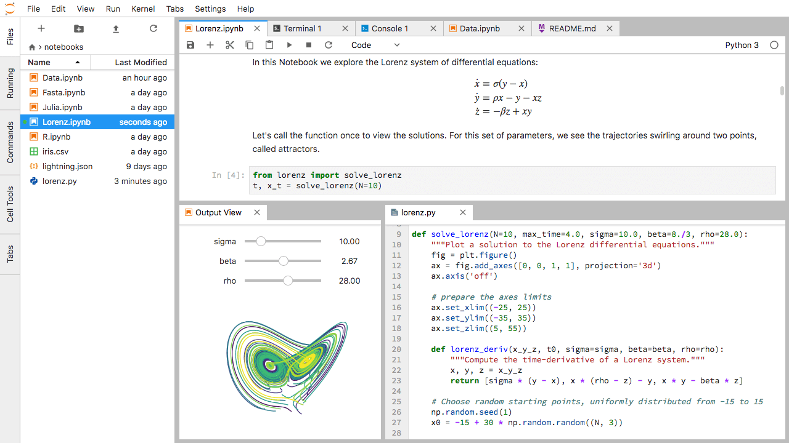
Lab I. JupyterLab
Notes:
Jupyter Notebook is a web-based interactive computational environment for creating Jupyter notebook documents. It supports several languages like Python (IPython), Julia, R etc. and is largely used for data analysis, data visualization and further interactive, exploratory computing.
JupyterLab is the next-generation user interface including notebooks. It has a modular structure, where you can open several notebooks or files (e.g. HTML, Text, Markdowns etc) as tabs in the same window. It offers more of an IDE-like experience.
For a beginner I would suggest starting with Jupyter Notebook as it just consists of a filebrowser and an (notebook) editor view. It might be easier to use. If you want more features, switch to JupyterLab. JupyterLab offers much more features and an enhanced interface, which can be extended through extensions: JupyterLab Extensions (GitHub)

Slide 4
L1 - Resources
Texas A&M High Performance Research Computing (HPRC)
Ada Quick Start Guide
HPRC Portal
HPRC YouTube Channel
Jupyter Project

Slide 5
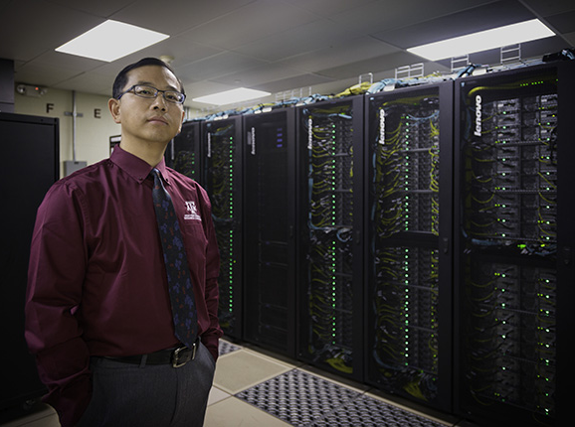
HPRC Systems - Terra & Ada
https://hprc.tamu.edu/resources/
Terra:
8,512-core hybrid system
304 28-core compute nodes equipped with the INTEL 14-core 2.4GHz Broadwell processor
48 GPU compute nodes with one NVIDIA K80
Interconnect fabric is Intel OmniPath Architecture (OPA)
Ada:
17,340-core hybrid system
845 20-core nodes equipped with the INTEL 10-core 2.5GHz IvyBridge processor.
15 nodes are 1TB and 2TB memory, 4-processor SMPs configured with the Intel 10-core 2.7GHz Westmere processors
30 GPU compute nodes with 2 NVIDIA K20
4 GPU compute nodes with 2 NVIDIA V100
Dr. Honggao Liu, Director
High Performance Research Computing
Notes:
condense terra/ada and Lonestar into one slide.

Slide 6
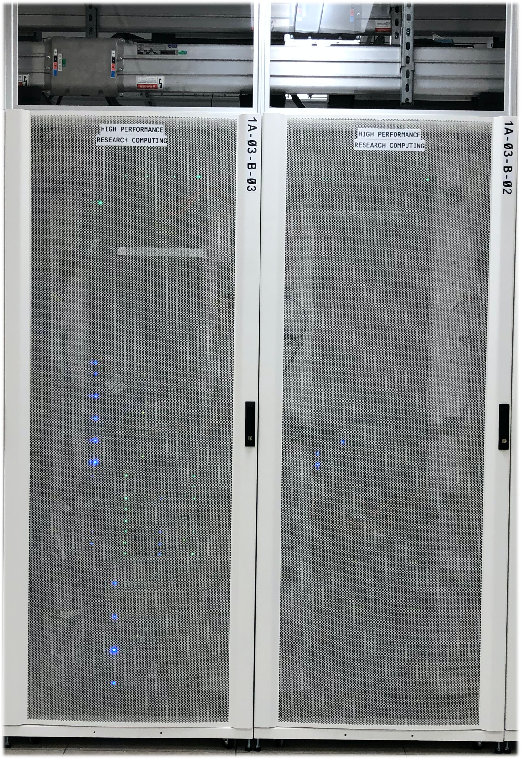
ViDaL: Secure & Compliant System
ViDaL (Texas Virtual Data Library): https://vidal.tamu.edu
A 24-node secure and compliant computing environment that supports data intensive research using sensitive person-level data or proprietary licensed data to meet the myriad legal requirements of handling such data (e.g., HIPAA, Texas HB 300, NDA)
16 compute nodes with 192 GB Ram each and 4 large memory nodes with 1.5 TB Ram each, and 4 GPU nodes with 192 GB Ram and two NVIDIA V100 16GB GPUs each
Both Windows and Linux environment.
2 PB high performance DDN storage running IBM Spectrum Scale filesystem.
Crowdstrike (antivirus/malware software) is used. Vidal systems are patched monthly. Splunk will be used for security information and event management
Each Vidal server/VM is configured based on the CIS security benchmarks for Linux and Windows OSes and the TAMU Information Security Control Catalog.
Housed in the secure West Campus Data Center

Slide 7
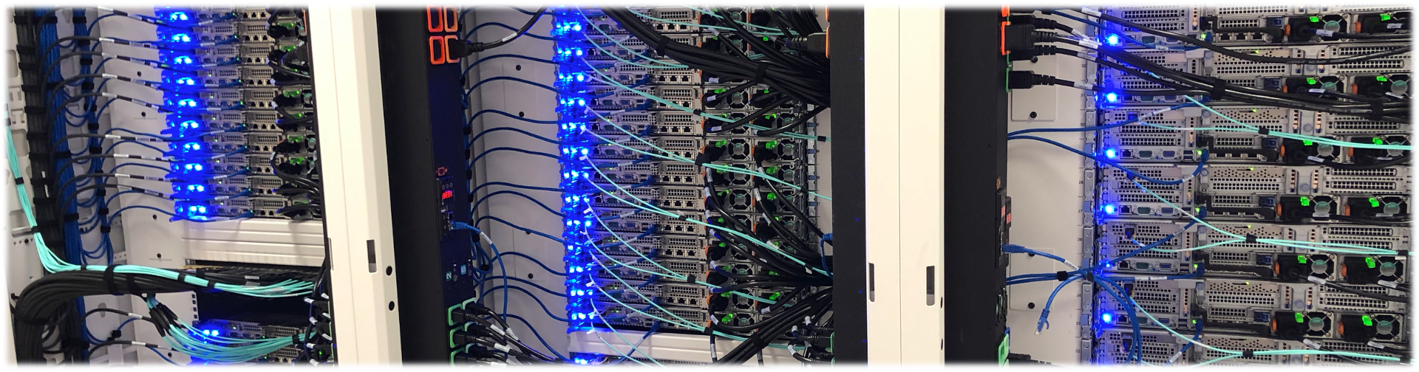
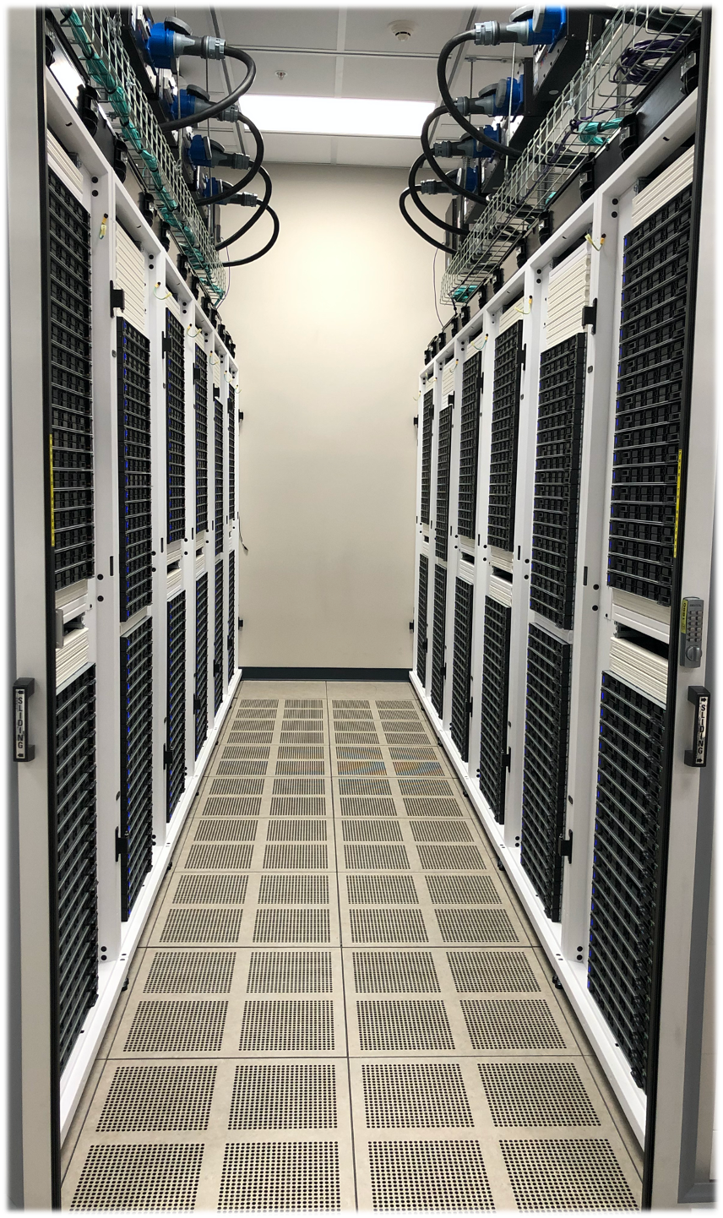
GRACE
Currently in Deployment
The aggregate peak performance computing capacity is over 6 PFLOPS.
800 compute nodes equipped with 2 Intel 24-core 3.0 GHz processors and 384GB memory
100 GPU compute nodes have 2 NVIDIA A100 48GB GPUs with 2 Intel 24-core 3.0 GHz processors and 384GB memory
8 GPU compute nodes with 4 single precision T4 16GB
9 GPU compute nodes with 2 RTX6000 24GB GPUs, 2 Intel 24-core 3.0 GHz processors and 384GB memory
8 large memory compute nodes with 4 Intel 20-core 2.5GHz processors and 3.072 TB memory
5.12 PB of usable high-performance storage running Lustre parallel filesystem
Notes:
A100 (multi instance GPU) - up to seven separate GPU Instances for CUDA applications

Slide 8
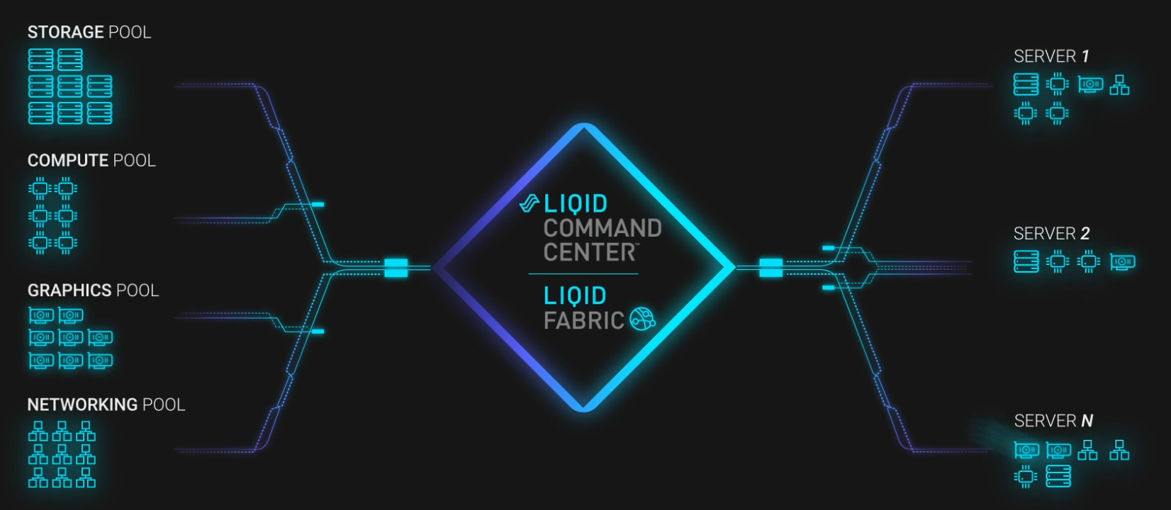
FASTER
Fostering Accelerated Scientific Transformations, Education, and Research
To be deployed in Spring 2021
Funded by NSF MRI grant ($3.09M + $1.32M TAMU match)
Adopts the innovative LIQID composable software-hardware approach combined with cutting-edge technologies.
Equipped with NVIDIA A100, and T4/T4-Next GPUs for AI/DL/ML workloads. Each node can access 16+ GPUs.
Thirty percent of FASTER’s computing resources will be allocated to researchers nationwide by the NSF XSEDE (Extreme Science and Engineering Discovery Environment) program.
FASTER project is supported by NSF award number 2019129

Slide 9
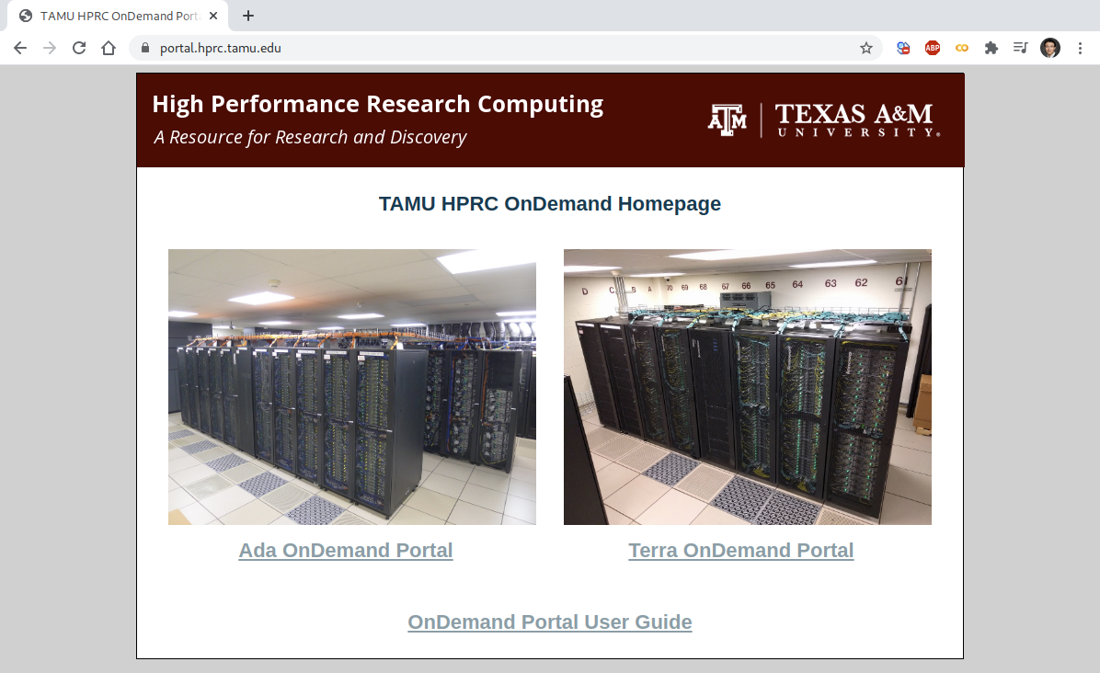
Login HPRC Portal

Slide 10
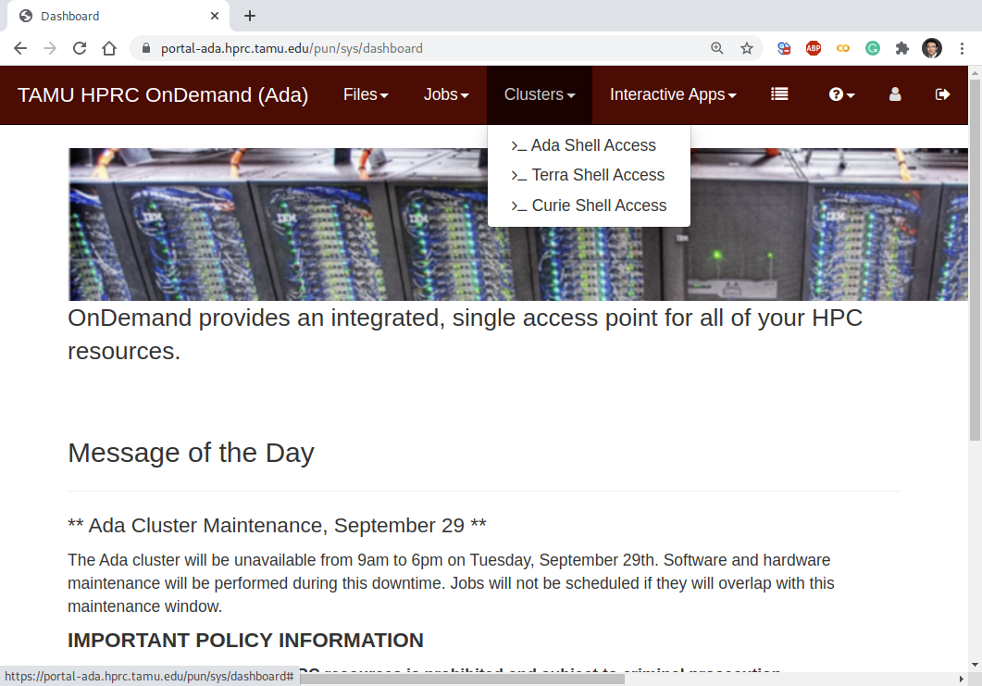
Shell Access - I

Slide 11
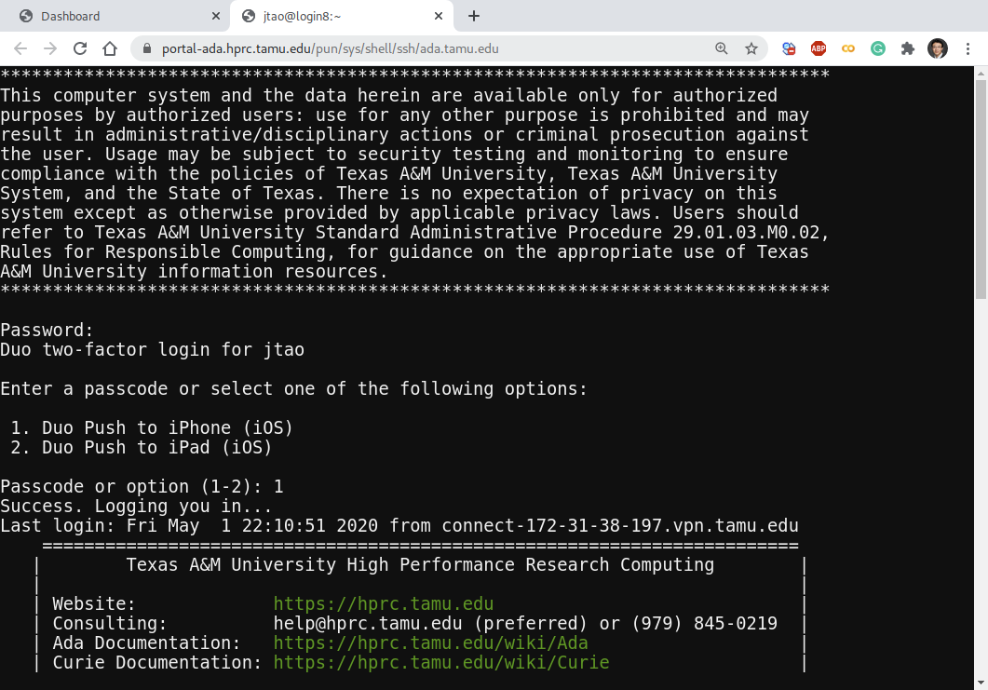
Shell Access - II

Slide 12
Python Virtual Environment (VENV)
# clean up and load Anaconda
cd $SCRATCH
module purge
module load Anaconda/3-5.0.0.1
# create a Python virtual environment
conda create -n mylab
# activate the virtual environment
source activate mylab
# install required package to be used in the portal
conda install jupyterlab=1.2.2
conda install pandas matplotlib
conda install scikit-learn
conda install tensorflow
# deactivate the virtual environment
# source deactivate
Load Modules
Create a VENV
Activate the VENV
Install Python Modules
Deactivate (when not used)
Notes:
Some common issues: 1). running out of your quota for the number of files on $SCRATCH (need to email HPRC helpdesk (help@hprc.tamu.edu) to request an increase of your quota.); 2). make sure to load the right module with the right version numbers.
Try adding the conda-forge channel to your list of channels with this command: conda config --append channels conda-forge. It tells conda to also look on the conda-forge channel when you search for packages. You can then simply install the two packages with conda install slycot control.
Channels are basically servers for people to host packages on and the community-driven conda-forge is usually a good place to start when packages are not available via the standard channels. I checked and both slycot and control seem to be available there.
conda install -c conda-forge jupyterlab=1.2.2

Slide 13
Common Anaconda Commands
# Conda virtual environment
conda info # show Conda installation
conda create -n VENV # create a virtual environment
conda create -n VENV python=3.4 # create a venv with a py version
conda env list # list installed venv
# Conda package management
conda list # list all installed packages
conda search PACKAGENAME # search a Conda package
conda install PACKAGENAME # install a Conda package
conda update PACKAGENAME # update a Conda package
conda remove PACKAGENAME # remove a Conda package
# install required package to be used in the portal
conda install jupyterlab=1.2.2
conda install pandas matplotlib
conda install scikit-learn
conda install tensorflow
Notes:
Some common issues: 1). running out of your quota for the number of files on $SCRATCH (need to email HPRC helpdesk (help@hprc.tamu.edu) to request an increase of your quota.); 2). make sure to load the right module with the right version numbers.

Slide 14
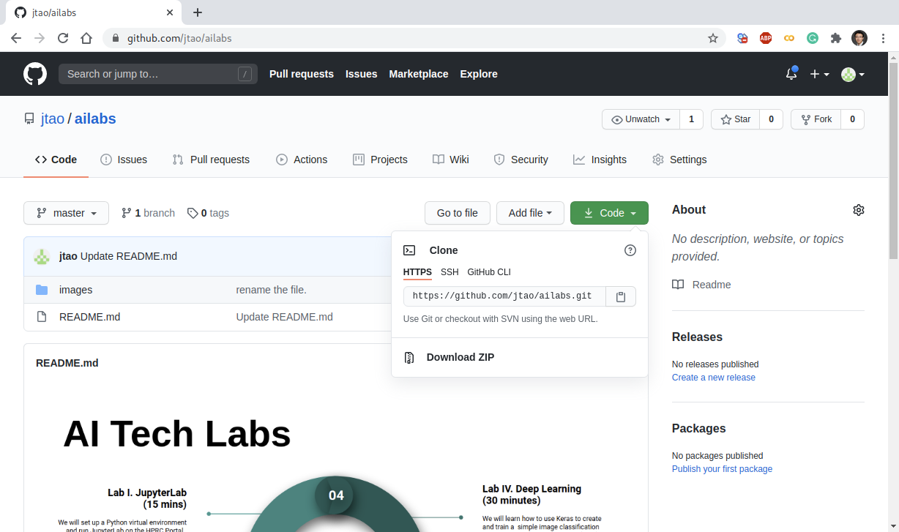
Check out Exercises
# git clone (check out) the Jupyter notebooks for the labs
git clone https://github.com/jtao/ailabs.git
Notes:
Some common issues: 1). running out of your quota for the number of files on $SCRATCH (need to email HPRC helpdesk (help@hprc.tamu.edu) to request an increase of your quota.); 2). make sure to load the right module with the right version numbers.

Slide 15
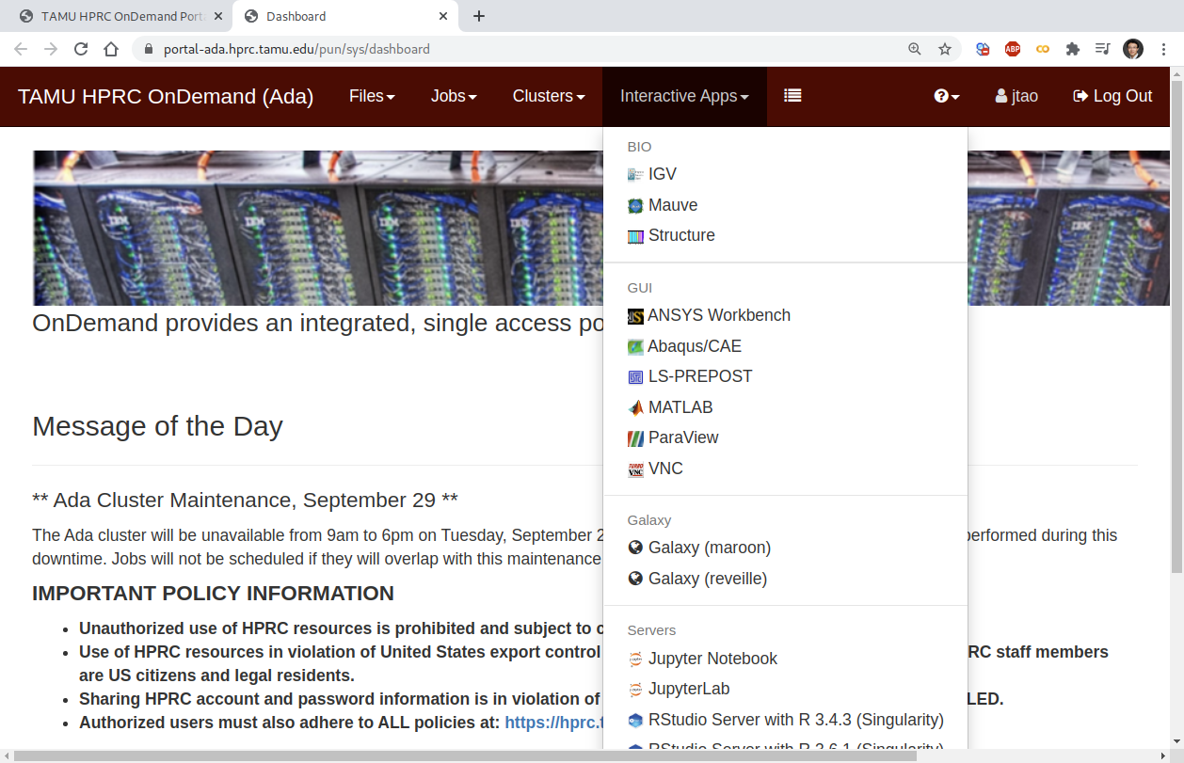
Go to JupyterLab Page

Slide 16
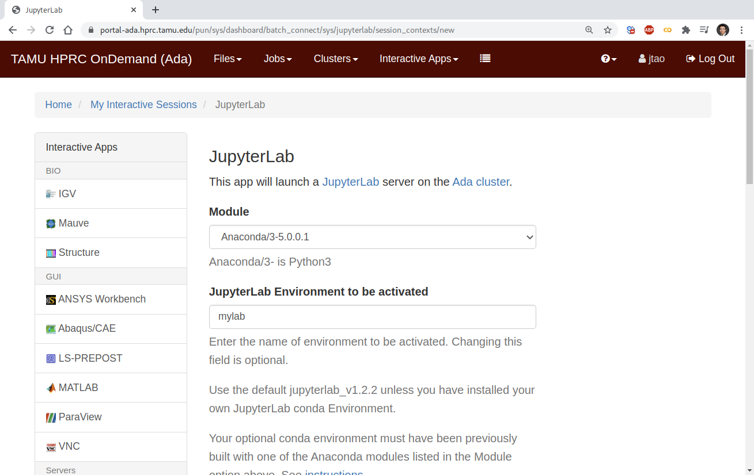
Set Virtual Environment

Slide 17
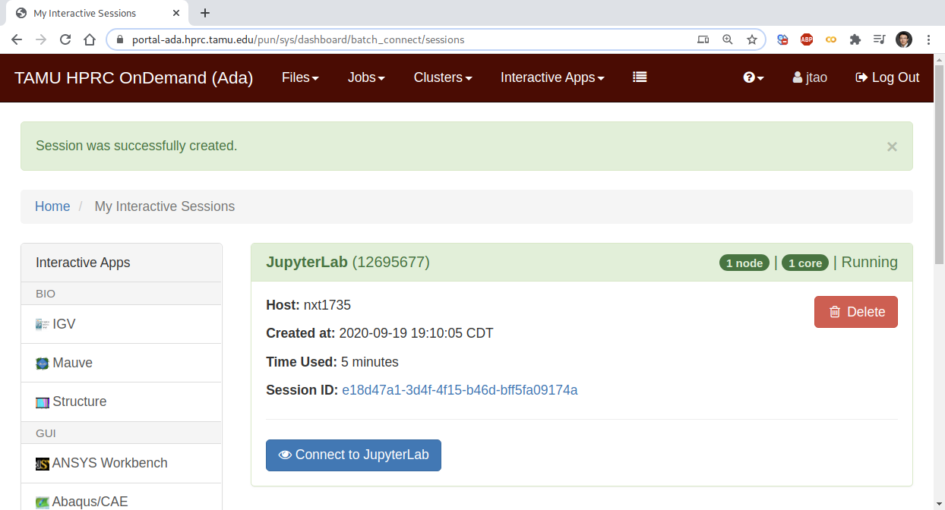
Connect to JupyterLab

Slide 18
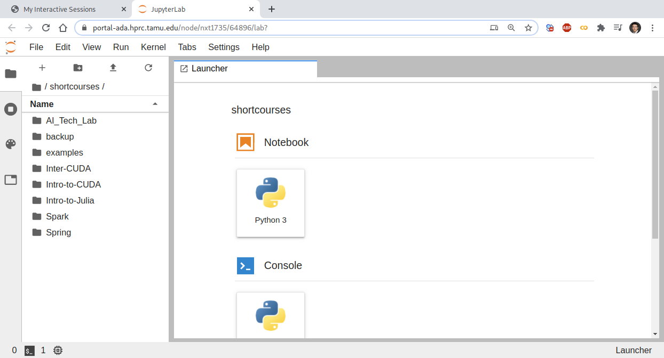
Create a Jupyter Notebook

Slide 19
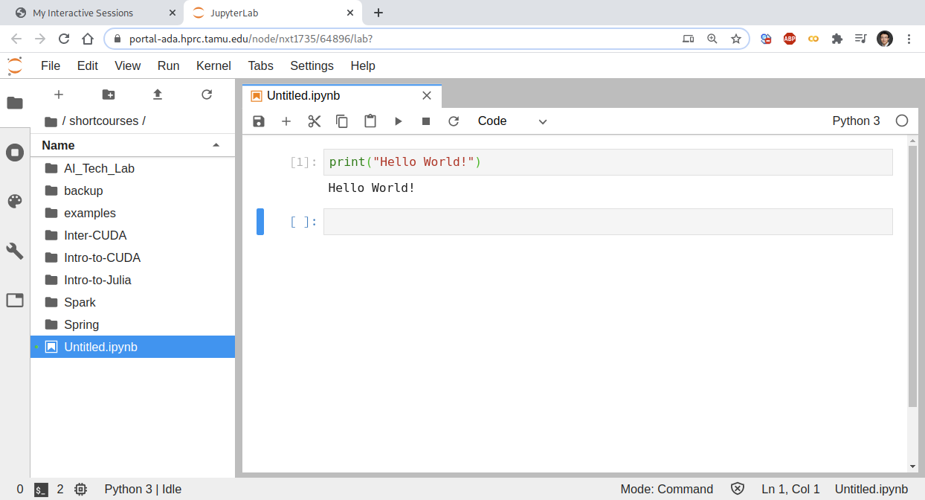
Test JupyterLab

Slide 20


Lab II. Data Exploration

Slide 21
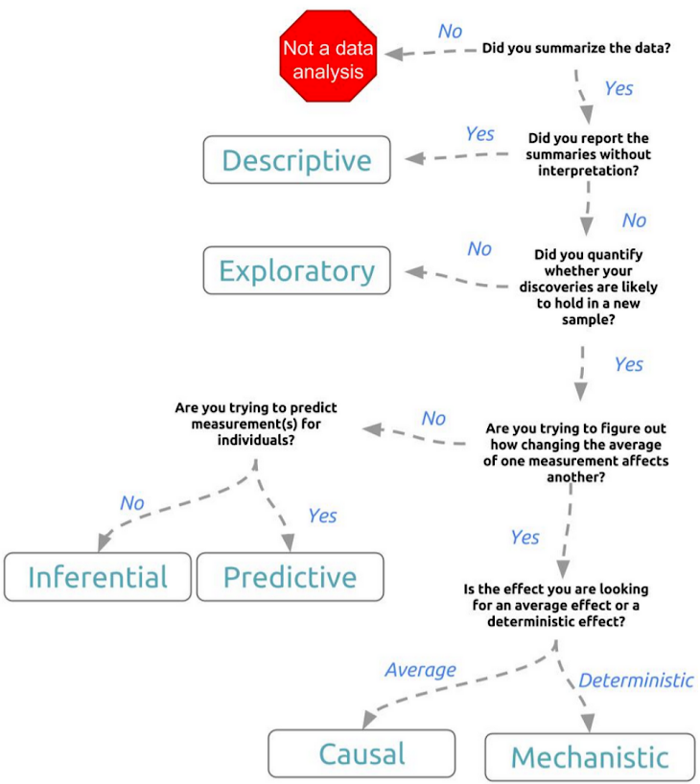
Types of Data Science Problems
Descriptive (summaries, e.g., census)
Exploratory (search for unknowns, e.g., SETI@home, Einstein@home)
Inferential (find correlations, e.g., many social studies)
Predictive (make predictions, e.g., Face ID, Echo, Siri)
Causal (explore causation, e.g., smoking versus lung cancer)
Mechanistic (determine governing principles, e.g., experimental science)
Credit: Jeff Leek - The Elements of Data Analytic Style

Slide 22
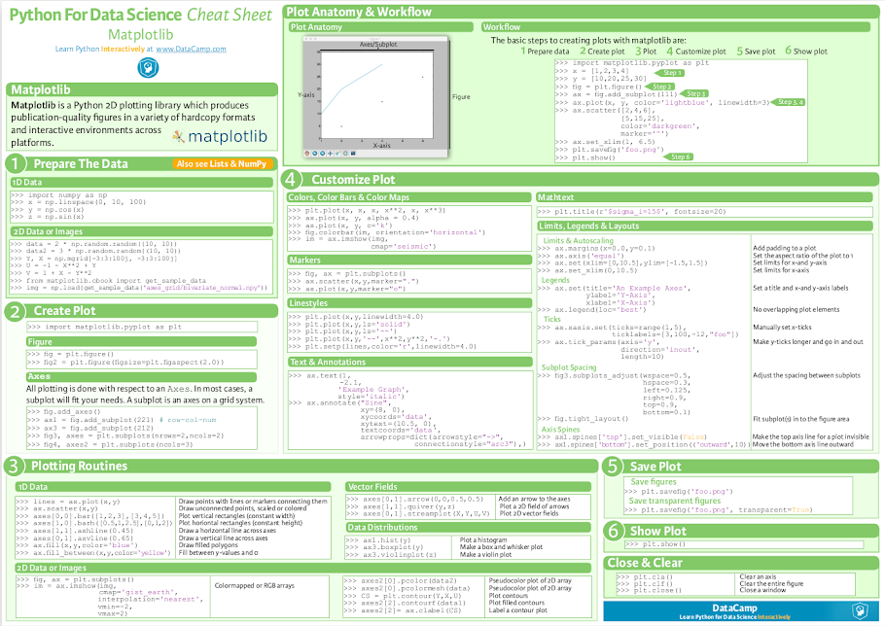
Matplotlib Cheat Sheet
https://s3.amazonaws.com/assets.datacamp.com/blog_assets/Python_Matplotlib_Cheat_Sheet.pdf

Slide 23
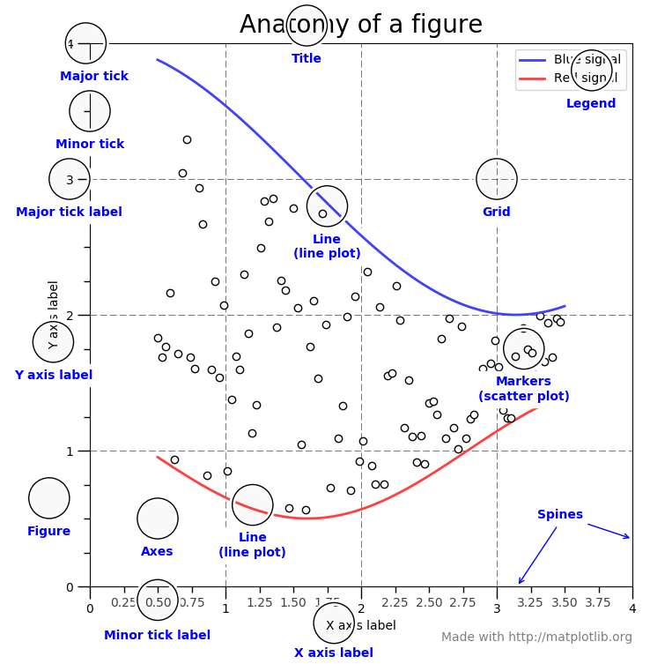
Key Plotting Concepts in Matplotlib
Matplotlib: Figure
Figure is the object that keeps the whole image output. Adjustable parameters include:
Image size (set_size_inches())
Whether to use tight_layout (set_tight_layout())
Matplotlib: Axes
Axes object represents the pair of axis that contain a single plot (x-axis and y-axis). The Axes object also has more adjustable parameters:
The plot frame (set_frame_on() or set_frame_off())
X-axis and Y-axis limits (set_xlim() and set_ylim())
X-axis and Y-axis Labels (set_xlabel() and set_ylabel())
The plot title (set_title())
(Credit: matplotlib.org)

Slide 24
Data Structures
Pandas has two data structures that are descriptive and optimized for data with different dimensions.
Series: 1D labeled homogeneously-typed array
DataFrame: General 2D labeled, size-mutable tabular structure with potentially heterogeneously-typed columns

Slide 25
Series in pandas
"Series is a one-dimensional labeled array capable of holding any data type (integers, strings, floating point numbers, Python objects, etc.). The axis labels are collectively referred to as the index." - pandas site
In [3]: s = pd.Series(np.random.randn(5),
index=['a', 'b', 'c', 'd', 'e'])
In [5]: s.index
In [6]: pd.Series(np.random.randn(5))
In [7]: d = {'b': 1, 'a': 0, 'c': 2}
In [8]: pd.Series(d)
In [12]: pd.Series(5., index=['a', 'b', 'c', 'd', 'e'])
Index
Value
A
0
B
1
C
2
D
E

Slide 26
DataFrame in pandas
"Two-dimensional size-mutable, potentially heterogeneous tabular data structure with labeled axes (rows and columns). Arithmetic operations align on both row and column labels. Can be thought of as a dict-like container for Series objects. The primary pandas data structure." - pandas site
Columns
In [2]: d = {'col1': [1, 2], 'col2': [3, 4]}
In [3]: df = pd.DataFrame(data=d)
In [5]: df.index
In [6]: df = pd.DataFrame(
np.array([[1, 2, 3], [4, 5, 6], [7, 8, 9]]),
columns=['a', 'b', 'c'])
Index
C1 C2 C3 C4
A
0
x
0.1
True
B
1
y
2.4
False
C
2
z
1.9
True
D
NA
w
8.3
False
E
9
a
6.8
False
Notes:
Dataframe sort
Dtaframe Rank row or column
The matplotlib object-oriented API
Df.infro
Print a concise summary of a DataFrame.
This method prints information about a DataFrame including the index dtype and columns, non-null values and memory usage.
UTF-8 is a variable-width character encoding used for electronic communication. Defined by the Unicode Standard, the name is derived from Unicode Transformation Format – 8-bit. UTF-8 is capable of encoding all 1,112,064 valid character code points in Unicode using one to four one-byte code units.

Slide 27
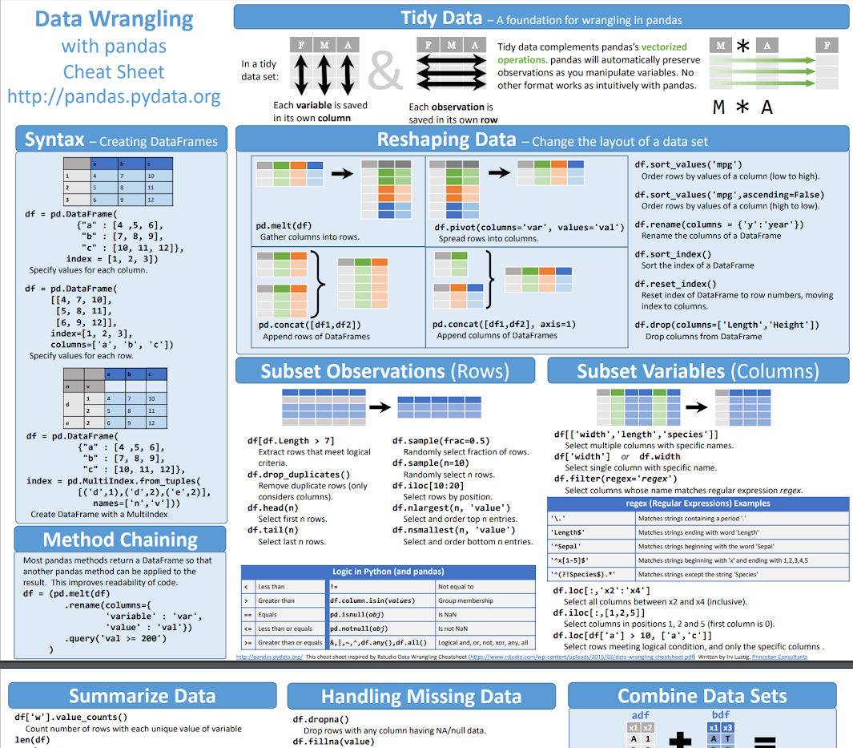
Pandas Cheat Sheet
https://pandas.pydata.org/Pandas_Cheat_Sheet.pdf

Slide 28

Lab III. Machine Learning

Slide 29

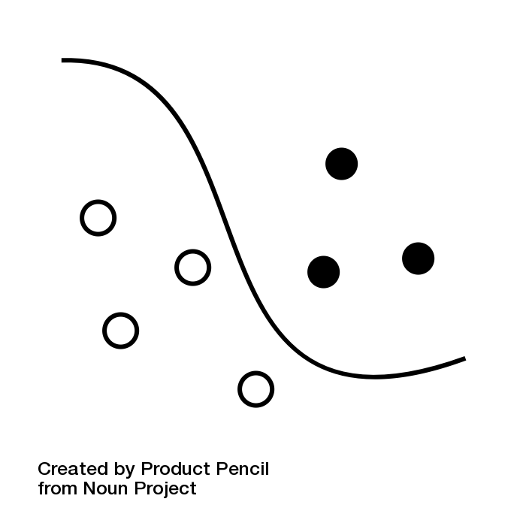
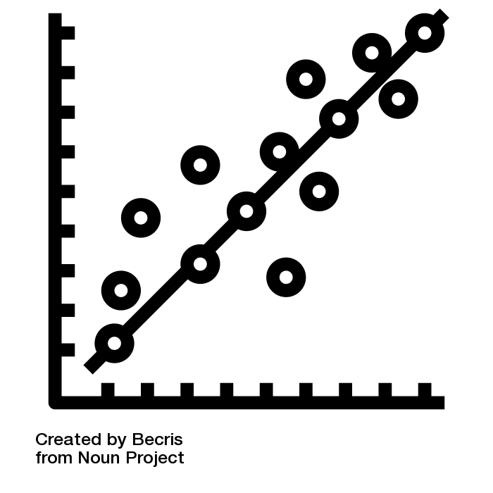

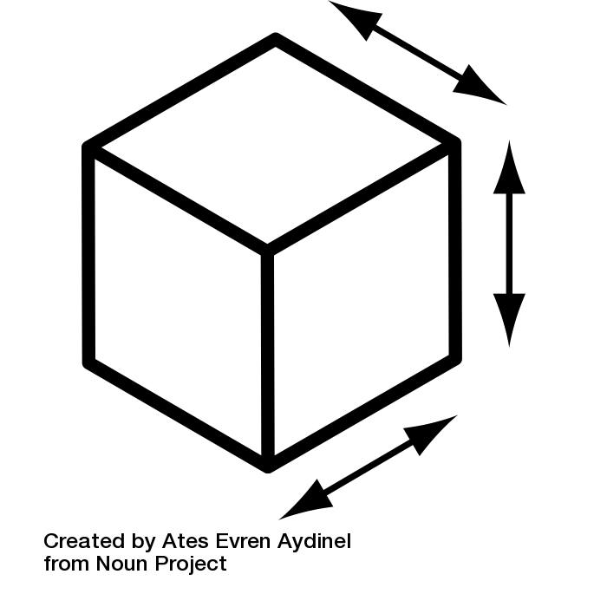
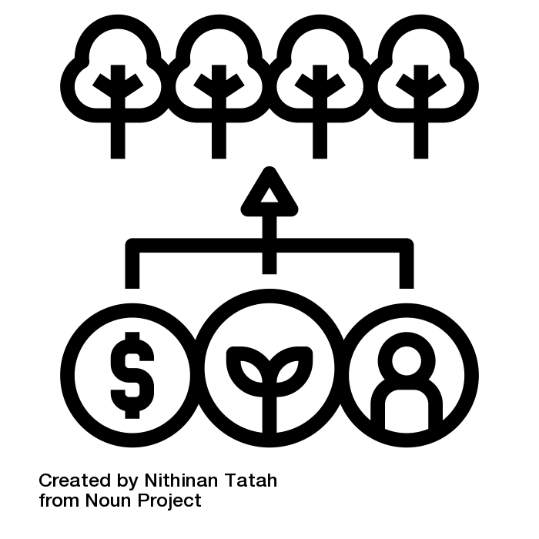

Main Features of scikit-learn
Classification
Regression
Clustering
Dimension Reduction
Model Selection
Preprocessing
Identifying category of an object
Predicting a attribute for an object
Grouping similar objects into sets
Reducing the number of dimensions
Selecting models with parameter search
Preprocessing data to prepare for modeling
Applications: Spam detection, image recognition. Algorithms: SVM, nearest neighbors, random forest, and more...
Applications: Drug response, Stock prices. Algorithms: SVR, nearest neighbors, random forest, and more...
Applications: Customer segmentation, Grouping experiment outcomes Algorithms: k-Means, spectral clustering, mean-shift, and more...
Applications: Visualization, Increased efficiency Algorithms: k-Means, feature selection, non-negative matrix factorization, and more...
Applications: Improved accuracy via parameter tuning Algorithms: grid search, cross validation, metrics, and more...
Applications: Transforming input data such as text for use with machine learning algorithms. Algorithms: preprocessing, feature extraction, and more...
Jian Tao @ Texas A&M Engineering Experiment Station
Credit: icons are from The Noun Project under Creative Commons Licenses

Slide 30


Lab IV. Deep Learning
Deep Learning
by Ian Goodfellow, Yoshua Bengio, and Aaron Courville
http://www.deeplearningbook.org/
Animation of Neutron Networks
by Grant Sanderson
https://www.3blue1brown.com/
Visualization of CNN
by Adam Harley
https://www.cs.ryerson.ca/~aharley/vis/conv/

Slide 31
Relationship of AI, ML, and DL
Artificial Intelligence
Artificial Intelligence (AI) is anything about man-made intelligence exhibited by machines.
Machine Learning (ML) is an approach to achieve AI.
Deep Learning (DL) is one technique to implement ML.
Machine Learning
Deep Learning

Slide 32
Types of ML Algorithms
Supervised Learning
trained with labeled data; including regression and classification problems
Unsupervised Learning
trained with unlabeled data; clustering and association rule learning problems.
Reinforcement Learning
no training data; stochastic Markov decision process; robotics and self-driving cars.
Machine Learning
Supervised Learning
Unsupervised Learning
Reinforcement Learning
Notes:
Machine Learning at its most basic is the practice of using algorithms to parse data, learn from it, and then make a determination or prediction about something in the world.

Slide 33
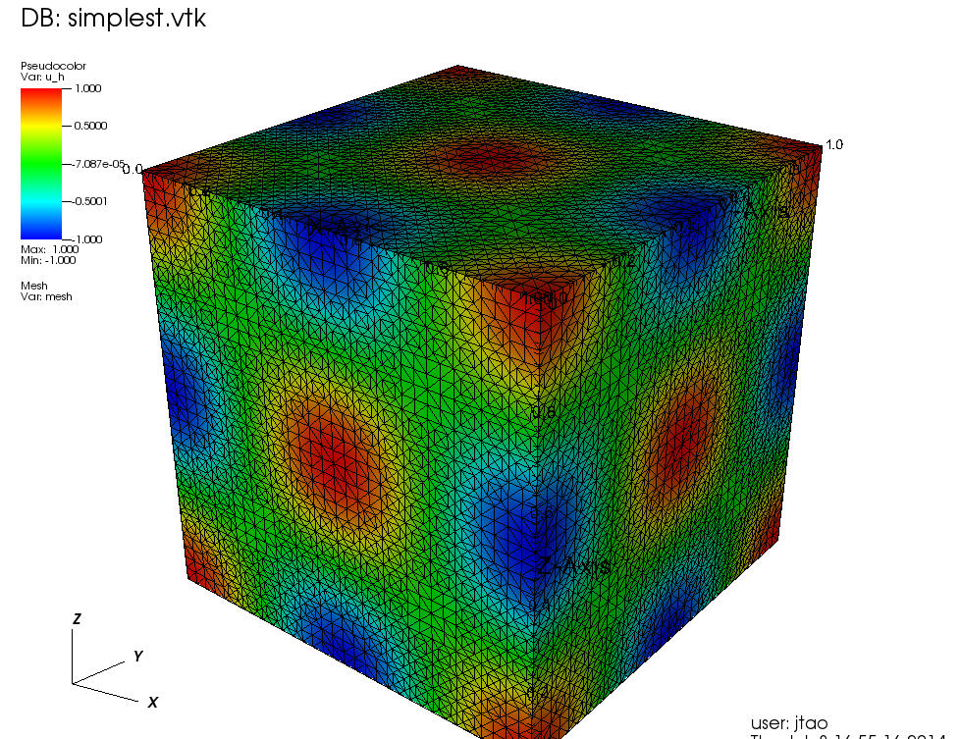
Machine Learning
Traditional Modeling
Data
Computer
Prediction
Scientific Model
Machine Learning (Supervised Learning)
Sample Data
Computer
Model
Expected Output
Model
Computer
Prediction
Data
Notes:
Credit: http://blogs.zeiss.com Comparison of traditional modeling approach with machine learning approach; In traditional modeling, domain knowledge is explicitly encoded, in program code, by a software developer, thus enabling the program to predict a result. For machine learning approaches the program code implements an abstract model. Its parameters are optimized based on sample data during the learning step. During prediction the model parameters are used to infer results on previously unseen data.

Slide 34
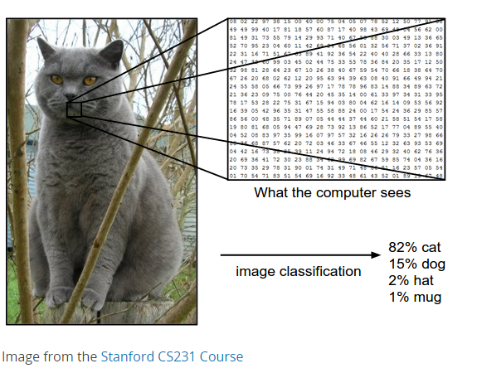
Inputs and Outputs
256 X 256 Matrix
DL model
4-Element Vector
X
Y
1
2
3
4
5
6
A
C
T
G
M
F
With deep learning, we are searching for a surjective (or onto) function f from a set X to a set Y.

Slide 35
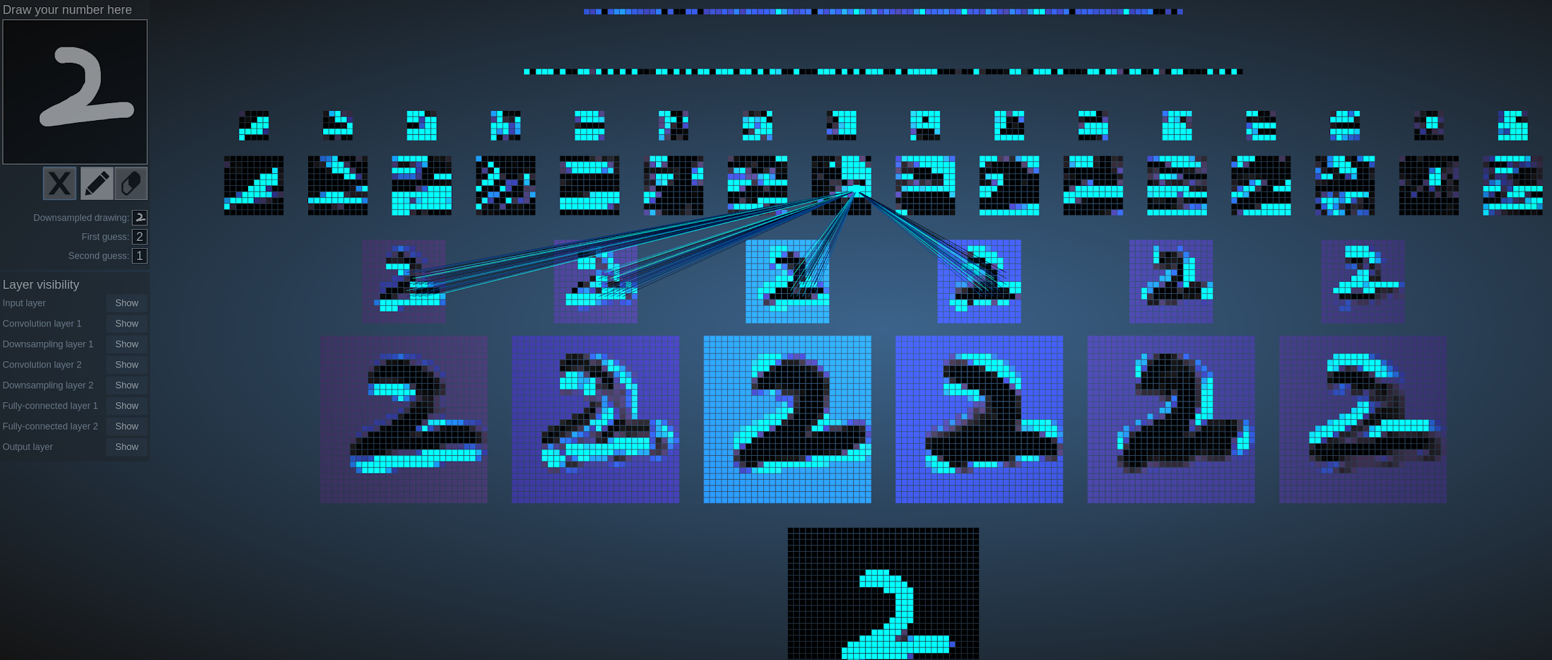
MNIST - CNN Visualization
(Image Credit: http://scs.ryerson.ca/~aharley/vis/)
Notes:
This network has 1024 nodes on the bottom layer (corresponding to pixels), six 5x5 (stride 1) convolutional filters in the first hidden layer, followed by sixteen 5x5 (stride 1) convolutional filters in the second hidden layer, then three fully-connected layers, with 120 nodes in the first, 100 nodes in the second, and 10 nodes in the third. The convolutional layers are each followed by downsampling layer that does 2x2 max pooling (with stride 2).

Slide 36
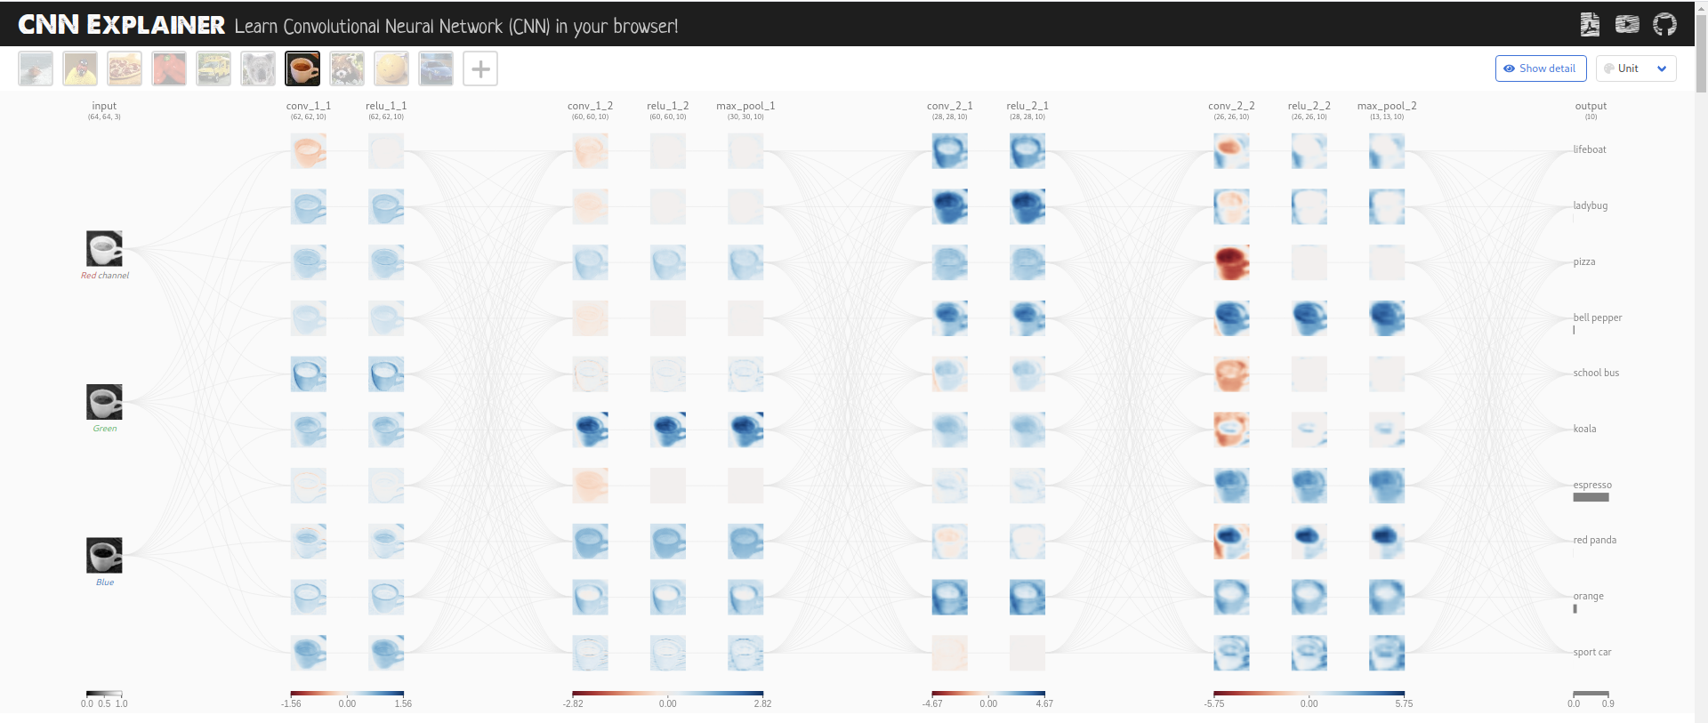
CNN Explainer
(Image Credit: https://poloclub.github.io/cnn-explainer/)

Slide 37
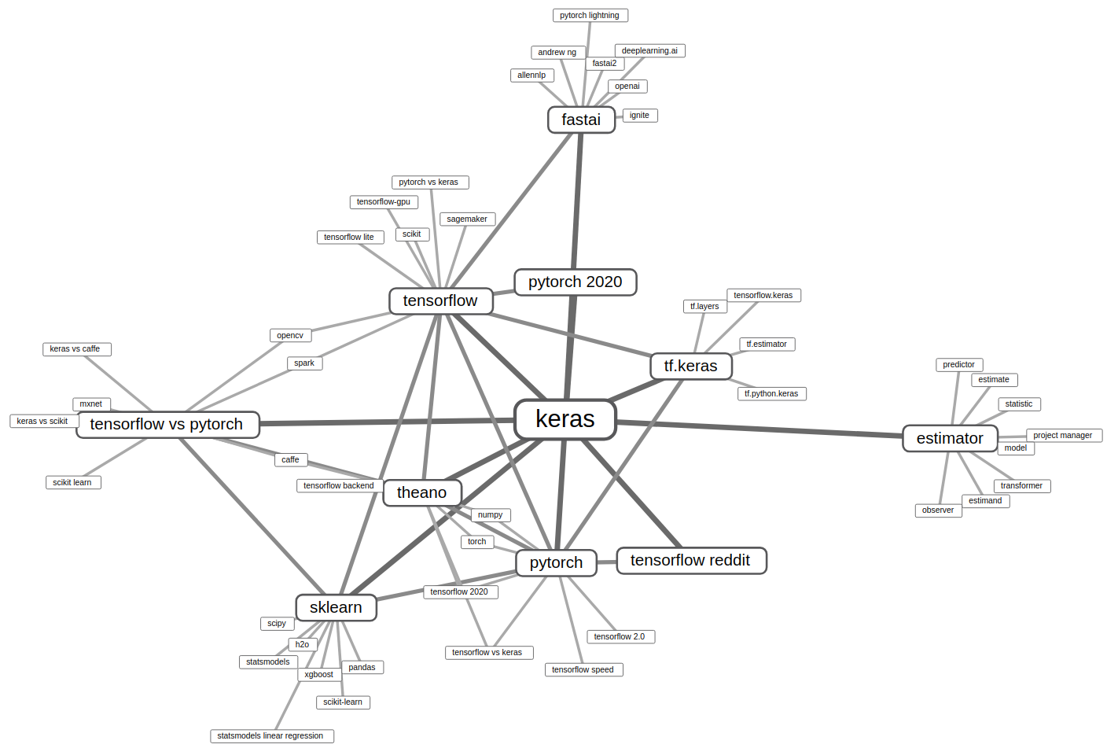
Credit: https://anvaka.github.io/vs/ (source)

Slide 38
Machine Learning Workflow with Keras
Step 1
Step 2
Step 3
Step 4
Prepare Train Data
Define Model
Training Configuration
Train Model
The preprocessed data set needs to be shuffled and splitted into training and testing data.
A model could be defined with Keras Sequential model for a linear stack of layers or Keras functional API for complex network.
The configuration of the training process requires the specification of an optimizer, a loss function, and a list of metrics.
The training begins by calling the fit function. The number of epochs and batch size need to be set. The measurement metrics need to be evaluated.

